Slide 1
Clustering Banks around Panamá City
Leonel Castillo

Slide 2
The Problem
Panamá City is known for its developed banking sector
How could we partition this sector into understandable clusters that give us business insight and could also inform decisions regarding the opening of new branches?

Slide 3
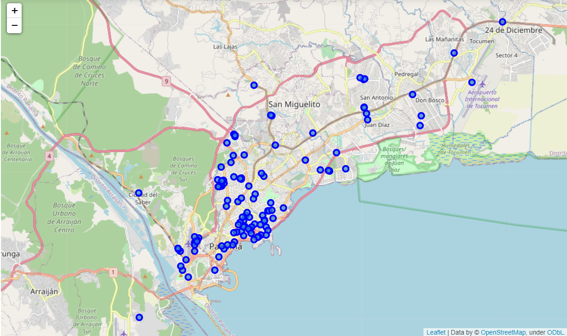
Banks around Panamá City

Slide 4
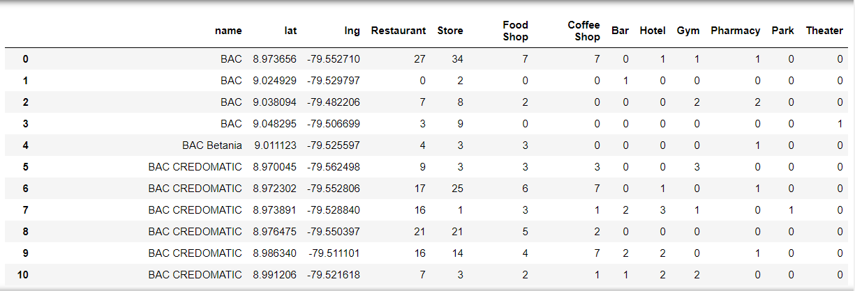
What should be considered?
We will consider 10 types of businesses that may be around a bank
We Will turn the frequency of that type of businesses into variables.
These variables are good proxies to how central a location the bank is around and the local wealth.

Slide 5
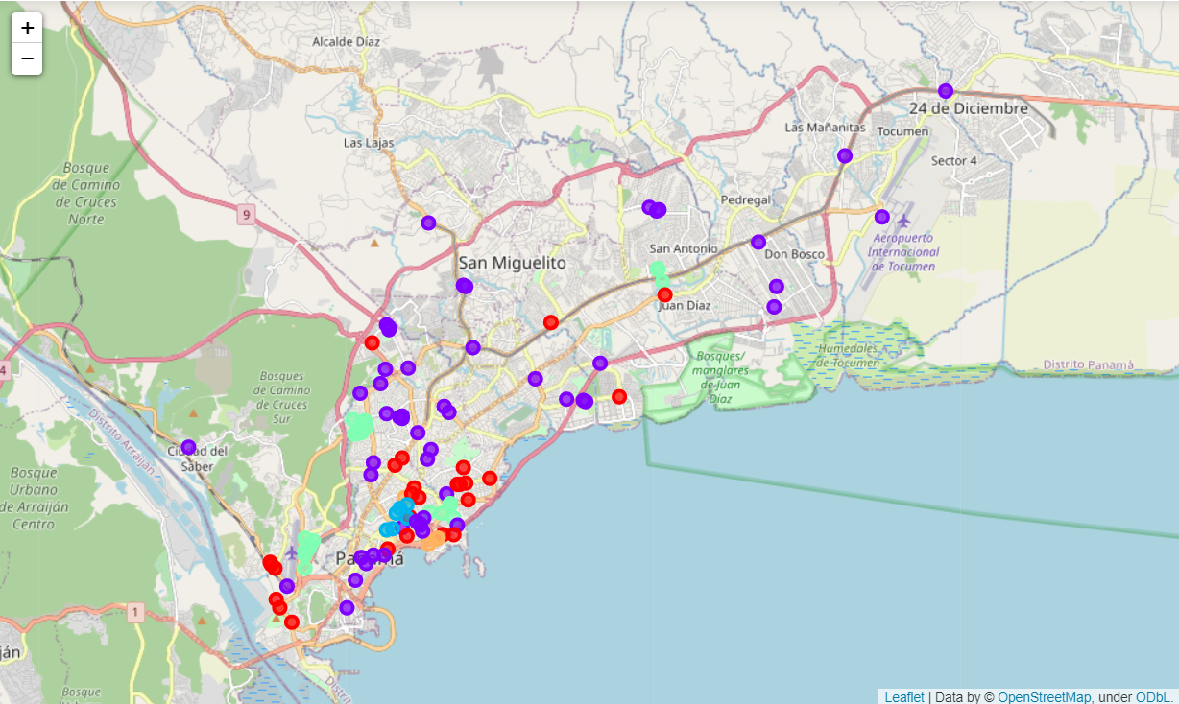
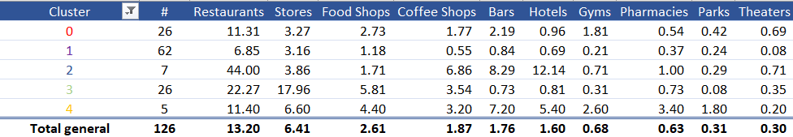
Results
Each of these clusters has a clear business sense.

Slide 6
Results - Clusters
These are middle-ground banks. They are located in good strategic locations for bank placement but are not the best areas. A bank should only look to open a branch in one of these sectors if they already have a dominant presence in the area.
These are outreach banks. They are placed in below-average locations not necessarily for the benefit that that particular location brings in but to make their customer’s lives a little more convenient.
The ultra-connected areas. These are the best placed banks in the whole region with the most access to local business. You can observe in the map that they are just one tiny cluster made of 7 banks in the middle of the city:
Banks near stores. If you look at the table you’ll notice that this cluster has every other cluster beat, even the ultra-connected, in the stores category. This category includes many types of stores and this means that these banks are around dense shopping centers with plenty of businesses around them.
General business banks. If you look at the table, you can notice that this cluster has a higher than average frequency of businesses in almost all categories. Therefore these are banks that are around a very varied selection of businesses. Likely around residential areas.

